Slide 1


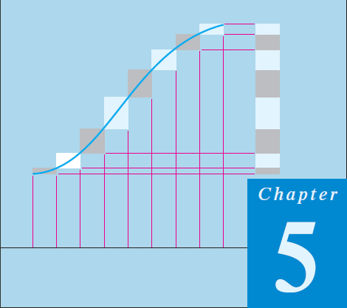
Thomas Calculus 11th
09
Integration Techniques 02
Samuel Lukas

Slide 2
Agenda
Integration Principle
Basic Integration Formulas
Integration by Parts
Integration of Rational Functions
Trigonometric Integrals
Trigonometric Substitutions
The Substitution Z = tan(x/2)
Improper Integrals

Slide 3
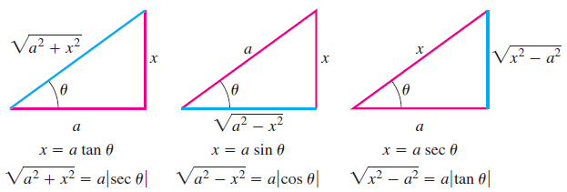





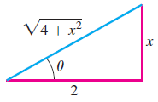

Trigonometric Substitutions

Slide 4




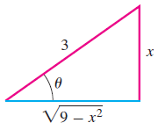




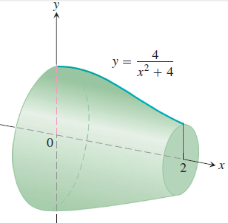



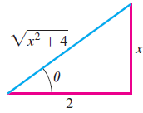



Slide 5










Exercises 1
16
17
18
19
20
21
22
23
24
25
26

Slide 6


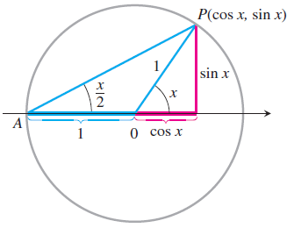
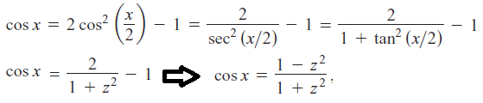
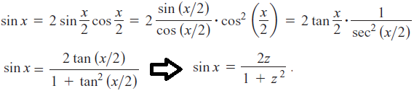

The Substitution Z = tan(x/2)

Slide 7














Examples

Slide 8










Exercises 2
01
02
03
04
05
06
07
08
Use the substitution $z=\tan\left(\frac{θ}{2}\right)$to evaluate the integrals in Exercises 95 and 96.
09
10

Slide 9
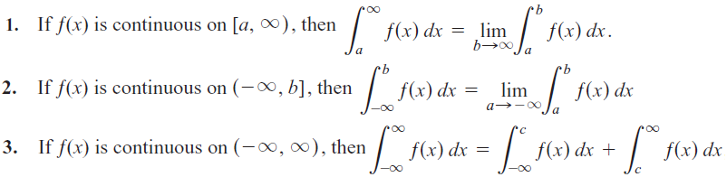
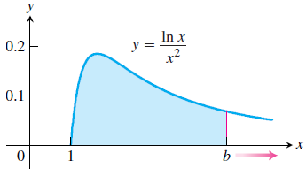






Improper Integrals

Slide 10
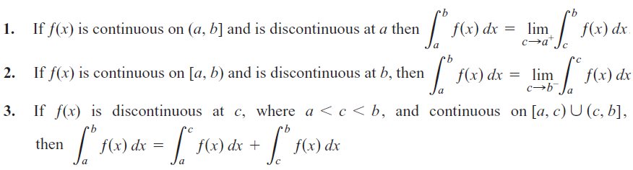


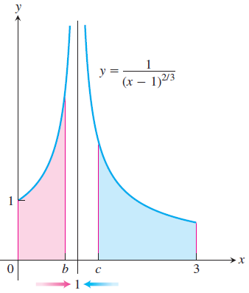
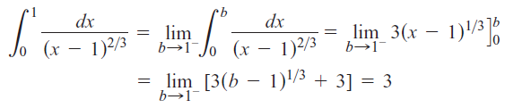
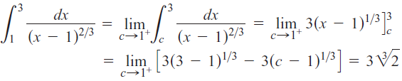


Slide 11














Exercises 3
01
02
03
04
05
06
07
08
09
10
11
12
13
14

